Slide 1
Processes and Process Management
Presentation by Sagar Chhabriya

Slide 2
Agenda
Process Concept
Process Scheduling
Operations on Processes
Interprocess communication
Communication in Client-Server Systems

Slide 3
Process and Program Concept
A process is a series of steps done to achieve a particular result or goal.
Process refers to an entity that helps in representing the fundamental unit of work.
Process is an active entity.
Program is a passive entity. (seq of instructions)

Slide 4
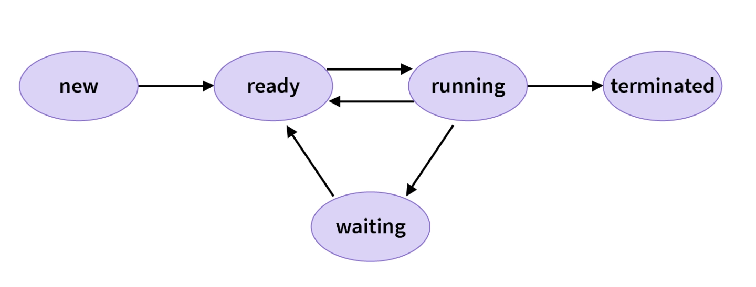
Process States or Life-Cycle

Slide 5
Process Scheduling
Process Scheduling is the process of the process manager handling the removal of an active process from the CPU and selecting another process based on a specific strategy.

Slide 6
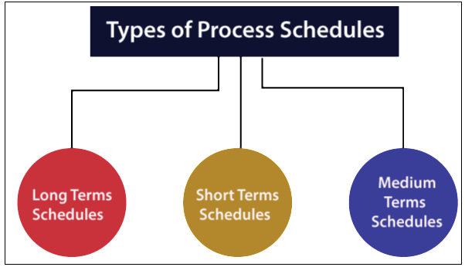
Process Scheduling (Dispatching/Scheduling)
Method by which OS decides which program gets to use the CPU next.
Long Term: Job Scheduler (Secondary Storage Layer, program)
Short Term: CPU Scheduler (Registers Layer, process)
Medium Term: Memory Swapper (Main Memory Layer, program + process)
Moving processes from main memory to disk and disk to main memory.
Notes:
Long term: select multiple pdf files and hit enter to open all at once.

Slide 7
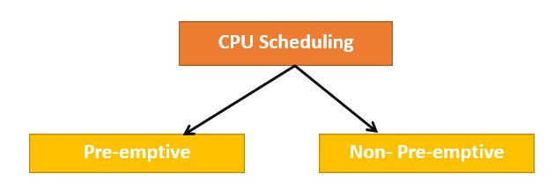
CPU Scheduling
The purpose of CPU Scheduling is to make the system more efficient, faster, and fairer.

Slide 8
Preemptive & Non-preemptive Scheduling.
Preemptive Scheduling – processes using the CPU can be removed by the system.
Non-preemptive scheduling – processes using the CPU cannot be removed by the CPU.

Slide 9
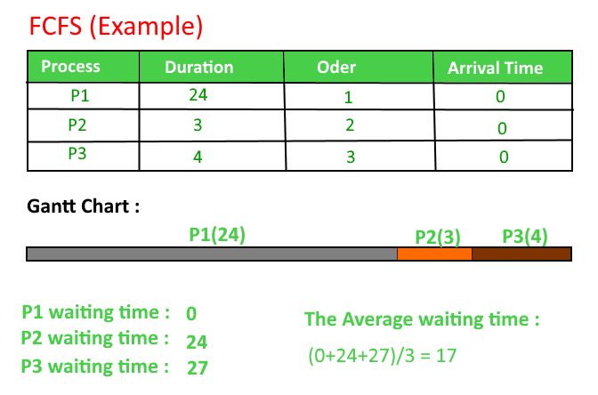

Slide 10
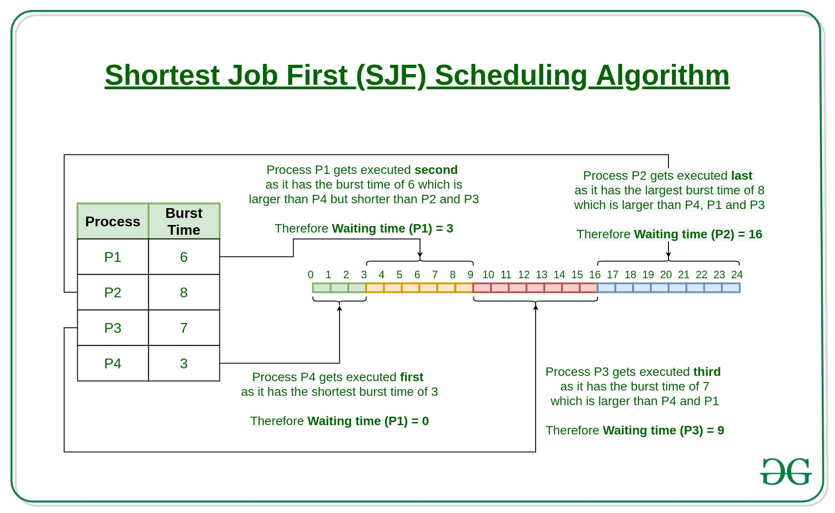

Slide 11

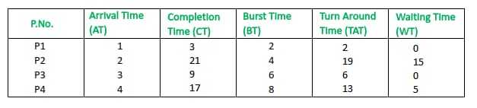
LJF (Longest Job First)

Slide 12
Operations on processes
Process operations involve the creation, scheduling, execution, and termination of processes.

Slide 13
Process Operations
The operations on process in OS ensure efficient utilization of system resources, multitasking, and a responsive computing environment.
The primary process operations in OS include:
Process Creation
Process Scheduling
Context Switching
Process Execution
Inter-Process Communication (IPC)
Process Termination
Process Synchronization

Slide 14
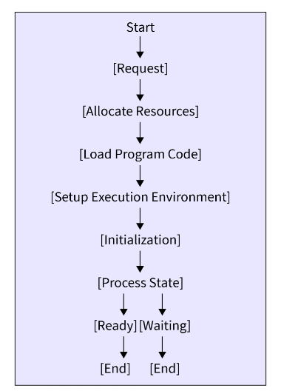
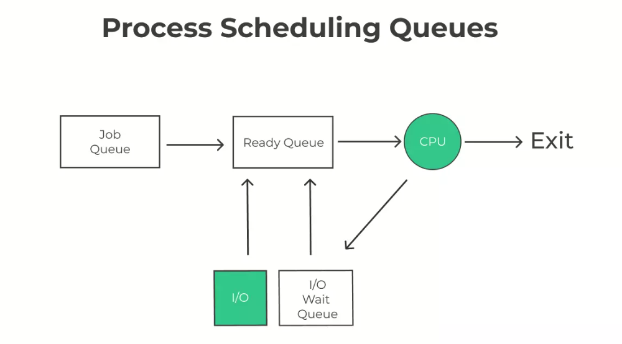
1. Process Creation | 2. Process Scheduling
Memory Mapping

Slide 15
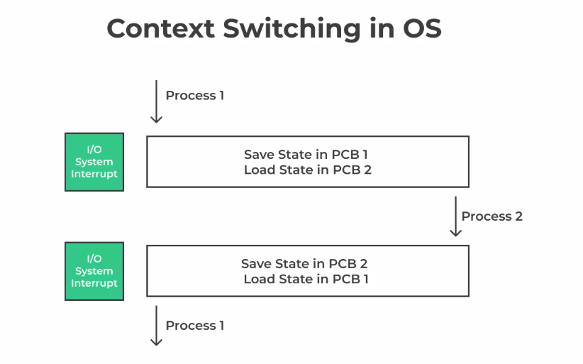
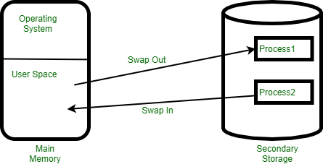
3. Context Switching

Slide 16
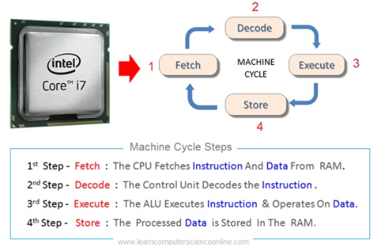
4. Process Execution
The CPU begins executing the instructions of the selected process.

Slide 17
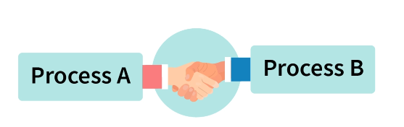
5. Interprocess Communication (IPC)
Interprocess communication in OS is a way by which multiple processes can communicate with each other.

Slide 18
IPC in Shared Memory Systems
Shared memory in OS, message queues, FIFO, etc are some of the ways to achieve IPC in OS.
Shared memory is used when two or more processes must share a large amount of data.

Slide 19
IPC in Message Passing System
Message passing is used when processes need to communicate with each other, but they are not related.

Slide 20
Examples of IPC Systems
Platform communication stack
Distributed Computing Environment (DCE)
Operating system communication stack
POSIX mmap, message queues, semaphores, and shared memory

Slide 21
Communication in Client-Server Systems
Typically, applications can use IPC, categorized as clients and servers, where the client requests data and the server responds to client requests.
Many applications are both clients and servers, as commonly seen in distributed computing.

Slide 22
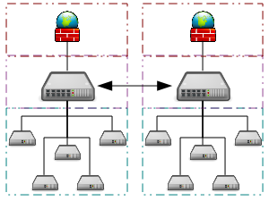
Interprocess Network Communication

Slide 23
A grid computing system that connects many personal computers over the Internet via inter-process network communication.
Grid Computing: Collection of heterogeneous clusters.
Cluster: Collection of homogenous nodes.

Slide 24
6. Process Termination
Process termination occurs when a process has completed its intended task, and it is no longer needed, or occurs when an error or exception occurs.
This operation involves several steps to ensure proper cleanup and resource reclamation such as Exit Status, and Process Control Block Update.

Slide 25
7. Synchronization in Inter-Process Communication
It is the process of ensuring that multiple processes are coordinated and do not interfere with each other.
This is important because processes can share data and resources, and if they are not synchronized, they can overwrite each other's data or cause other problems.

Slide 26
7. Synchronization in Inter Process Communication
-Mechanisms to provide process synchronization.
Mutual Exclusion
Condition Variables
Barriers
Semaphores

Slide 27
7. Synchronization in Inter Process Communication
1. Mutual Exclusion
This is a mechanism that ensures that only one process can access a shared resource at a time.
This is typically implemented using a lock, a data structure indicating whether a resource is available.

Slide 28
7. Synchronization in Inter Process Communication
2. Condition Variables
These are variables that can be used to wait for a certain condition to be met.
For example, a process could wait for a shared resource to become available before using it.

Slide 29
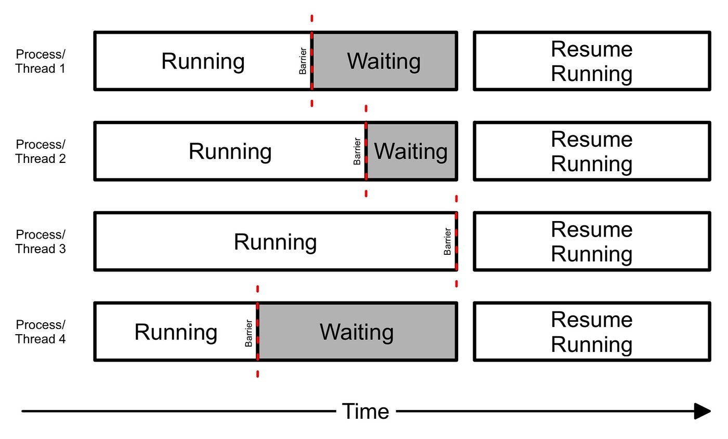
7. Synchronization in Inter Process Communication
3. Barriers
These are synchronization points that all processes must reach before they can proceed.
Notes:
This can be used to ensure that all processes have completed a certain task before moving on to the next task.

Slide 30
7. Synchronization in Inter-Process Communication
4. Semaphores
These are variables that can be used to count the number of times a shared resource is being used.
This can be used to prevent a resource from being used more than a certain number of times at the same time.

Slide 31
Synchronization Example:
In a database, multiple processes may need to access the same data.
Synchronization is used to ensure that only one process can write to the data at a time, and that other processes do not read the data while it is being written.

Slide 32
Today’s Talk was:
Process and Program Concept
Process States or Life-Cycle
Process Scheduling
(Dispatching/Scheduling)
---------------------------
IPC in Shared Memory Systems
IPC in Message Passing System
Examples of IPC Systems
Communication in Client-Server Systems
Interprocess Network Communication
Operations on processes
Process Creation
Process Scheduling
Context Switching
Process Execution
Inter-Process Communication (IPC)
Process Termination
Process Synchronization
Mutual Exclusion
Condition Variables
Barriers
Semaphores

Slide 33
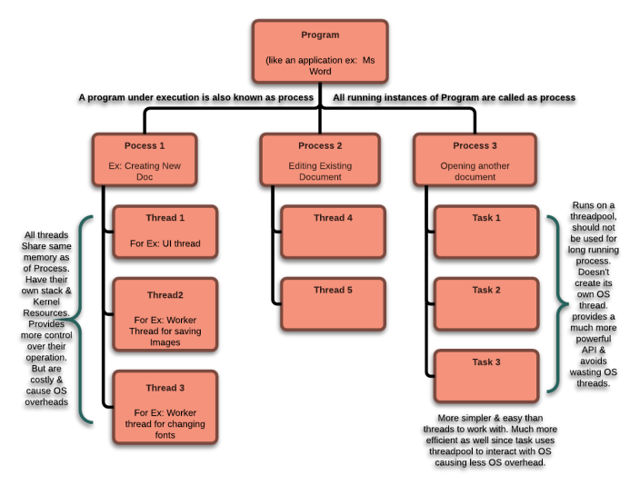
Program -Instructions for computer Process -Running program
Thread -Part of a process
Task -Job to be done

Slide 34

Thank you

